Slide 1
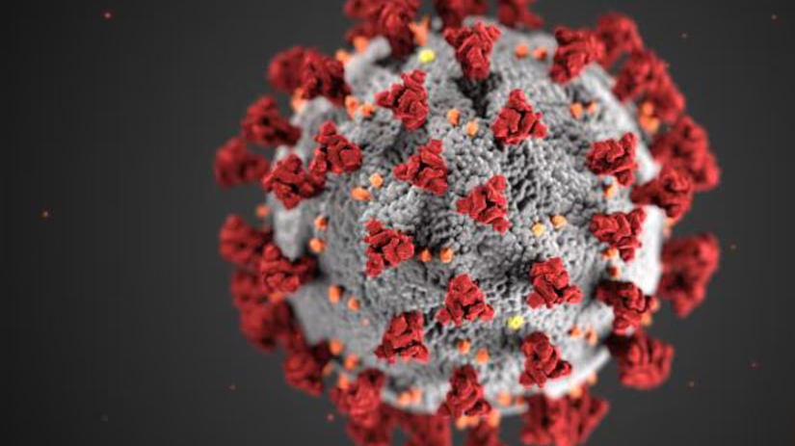
Conditions Contributing to COVID-19 Deaths, by State and Age, Provisional 2020-2023
View:
https://data.cdc.gov/NCHS/Conditions-Contributing-to-COVID-19-Deaths-by-Stat/hk9y-quqm/about_data
Download:
https://data.cdc.gov/api/views/hk9y-quqm/rows.csv?accessType=DOWNLOAD

Slide 2
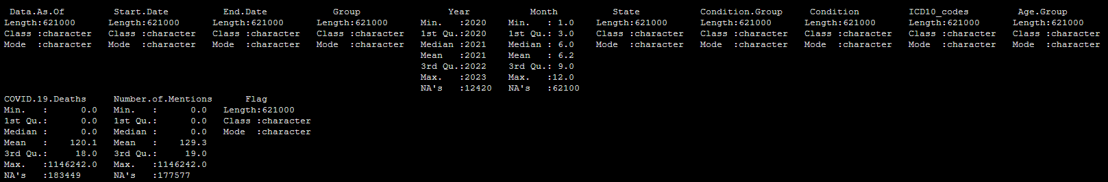
Summary of the Dataset
621000 observations of 14 variables
To start we can focus on a few of the independent variables and use “COVID.19.Deaths” as the dependent variable. We can group deaths by age group, by State, and by condition.

Slide 3
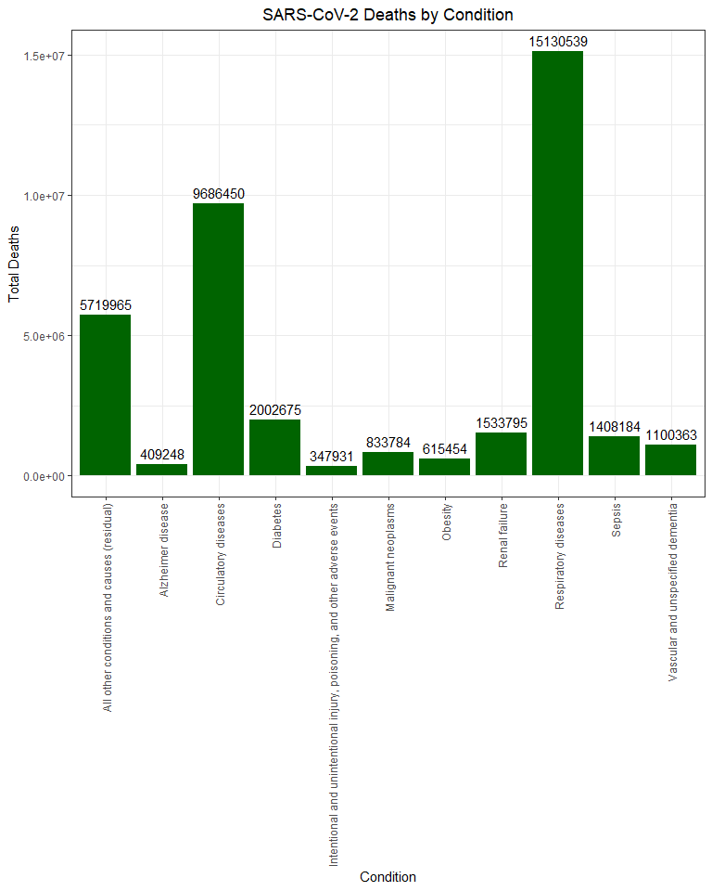
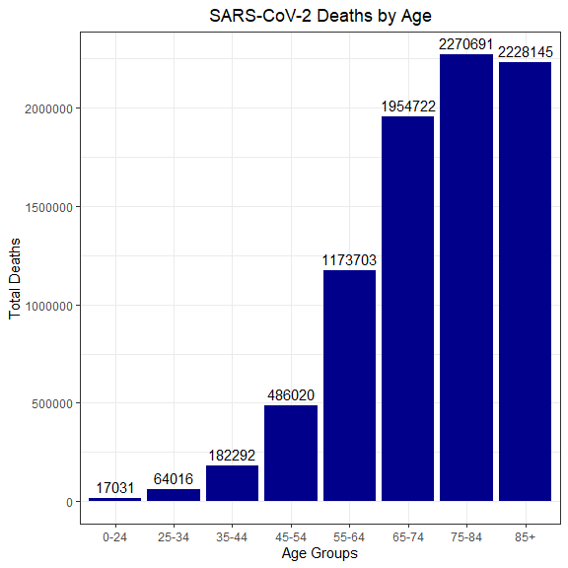
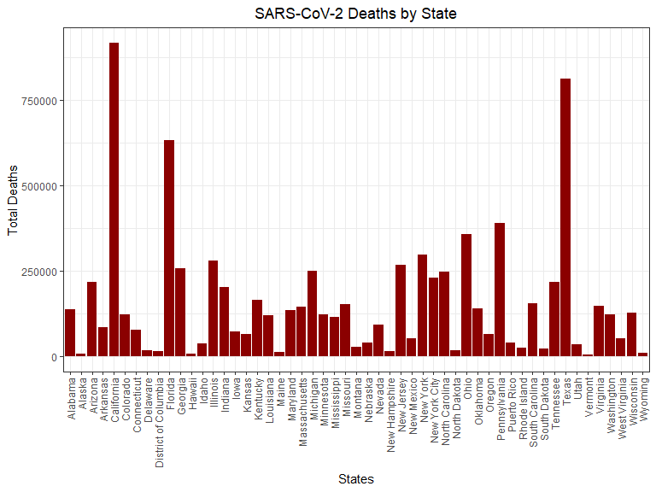
Exploring the Dataset
From here we can look at the subsets of data we have generated and form an exploratory question.
Do specific conditions happen more or less frequently based on location/State?

Slide 4
Investigating SARS-CoV-2 Comorbidities
We could look at each condition by State but let's investigate three comorbidities not commonly associated with SARS-CoV-2 (Alzheimer's disease, kidney failure, and sepsis).
Will there be a significant difference in Alzheimer's disease, kidney failure, and sepsis comorbidity deaths by geographic location?

Slide 5
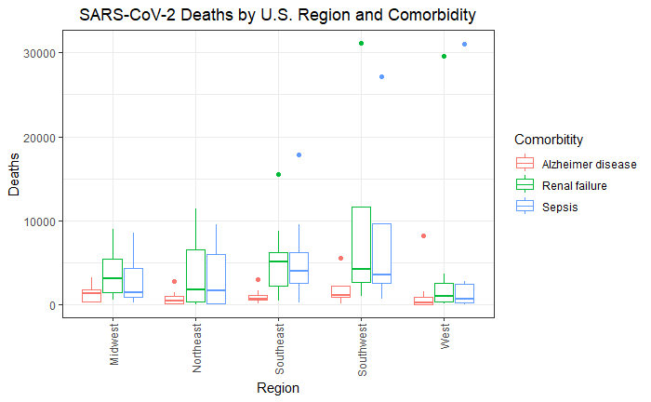
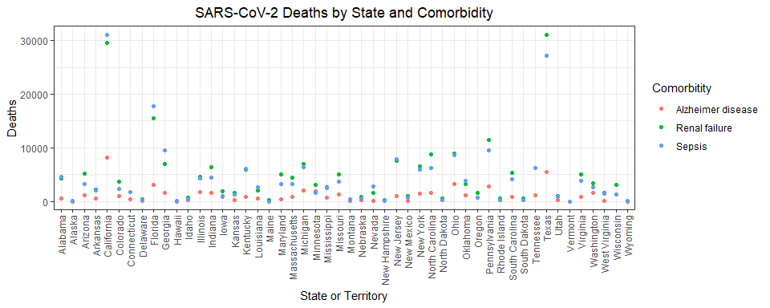
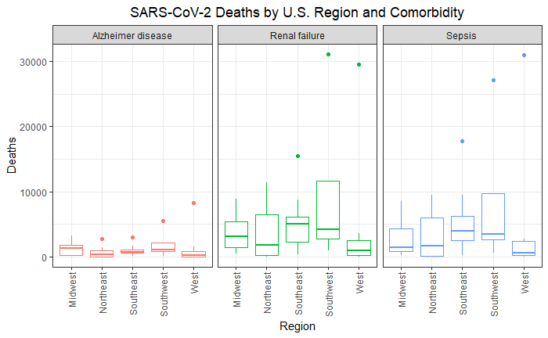
SARS-CoV-2 Comorbidity by Location
Here we look at the deaths by State. The plot is crowded and hard to interpret. The dataset was condensed by U.S. region to better visualize any differences based on geographic location.
Regions were determined by this map: https://education.nationalgeographic.org/resource/united-states-regions/

Slide 6



Analysis of Variance: Comorbidity ~ Region
Alzheimer’s disease:
Renal failure:
Sepsis:
Based on the ANOVA, there is no significant difference in Alzheimer’s disease, renal failure, or sepsis comorbidity with SARS-CoV-2 between based on U.S. regions.

